Slide 1

PRESENTATION TOPIC-BASICS OF DBMS
Submitted by:-
Yash Saxena
Tarun Makhija
Submitted to:-
Sir Saurabh Bhatt

Slide 2
What is Database?
Database is a collection of the relational data or information that is stored in a Computer System
For example:- Data is stored of students in school is relational i.e his name his mobile no his email etc

Slide 3
Why to use DBMS?
Data independence and efficient access
Reduced application development time
Data integrity and security
Uniform data administration
Concurrent access , recovery from crashes

Slide 4
What peoples used to store data in ancient times?
In ancient times people uses files, papers etc to use data or information which was very critical as it was unsecured files can get lost
As we know there are different types of data like image, text , video, audio etc it was difficult to use all these forms of data in ancient times
So now data is stored in computer which is easy to access ,store and delete data now

Slide 5
What is DBMS?
A Database management system (DBMS) or DBS consists of:-
A collection of interrelated and persistent data
A set of application program used to access, manage and update that data

Slide 6
Purpose of DBMS:-
1 )Data redundancy and inconsistency
Same information may be duplicated in several places
All copies may not be updated properly.
2 )Difficulty in new program to carry out each other a new task
3 )Data isolation:-
Data in different formats
Difficult to write new application programs.

Slide 7
Purpose of DBMS…
Security Problems
Every user of the system should be able to access only the data they are permitted
E.g. Payroll people only handle employee records ,and cannot see customer accounts ;tellers can only access account data and cant see payroll data
Difficult to enforce this with application programs etc..

Slide 8
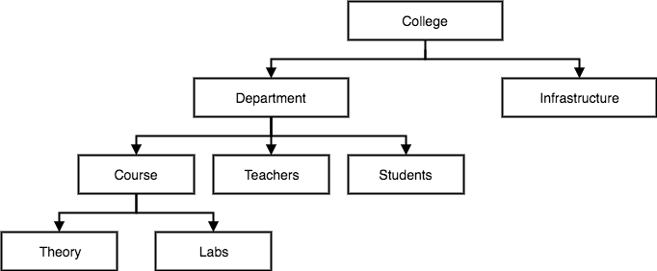
Database models:-
Hierarchical model:-
This database model organises data into a tree-like-structure, with a single root, to which all the other data is linked. The hierarchy starts from the Root data, and expands like a tree, adding child nodes to the parent nodes.
In hierarchical model, data is organised into tree-like structure with one one -to-many relationship between two different types of data in these model each child will have single parent node

Slide 9
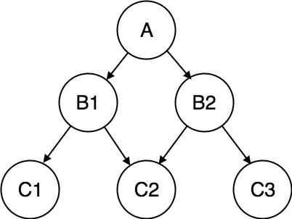
Network Model:-
This is an extension of the Hierarchical model. In this model data is organised more like a graph, and are allowed to have more than one parent node.
In this database model data is more related as more relationships are established in this database model. Also, as the data is more related, hence accessing the data is also easier and fast. This database model shows many-to-many relationships.
This was the most widely used database model, before Relational Model was introduced.

Slide 10
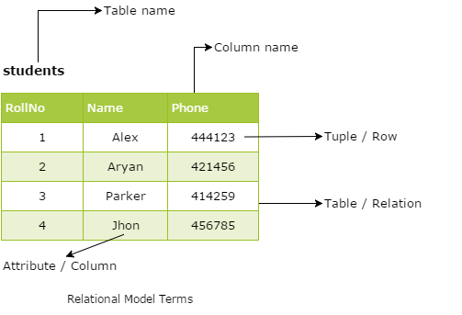
Relational Model:-
The most popular and extensively used data model is the relational data model. The data model allows the data to be stored in tables called a relation. The relations are normalized and the normalized relation values are known as atomic values.
Each of the rows in a relation is called tuples which contains the unique value. The attributes are the values in each of the columns which are of the same domain.

Slide 11
Object oriented Data model
Object DBMS add database functionality to object programming languages. They bring much more than persistent storage of programming language
S major benefit of this model is the unification of the application and database development into a seamless data model and language environmen

Slide 12
Semi structured model
In semi structured model ,the information that is normally associated with a schema is contained within the data, which is sometimes called self describing
In such databases there is no clear separation between the data and the schema, and the degree to which it is structured depends on the application

Slide 13
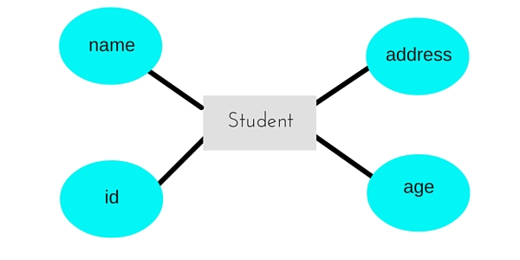
Entity Relationaship Model
The entity relational data model based on the perception of the real world that consist of a collection of basics objects and relationships between them. It is an object-based logical model. It is also high-level data model.

Slide 14
Advantages of DBMS
Controlling Redundancy
Sharing of data
Data consistency
Integration of data
Integration constraints
Data security
Report writers
Control over concurrency
Backup and recovery available
Data independence

Slide 15
Disadvantages of DBMS:-
Cost of hardware and software
Cost of data conversion
Cost of staff- training
Appointing technical staff
Database damage

Slide 16
Conclusion
A DBMS is a systematic operational system which consists of tools making data, data saving and data manipulation an easier task DBMS is the majorly used through out the world for data handling

